Slide 2
CLASSES
Presented by- Vikas Prajapats

Slide 3
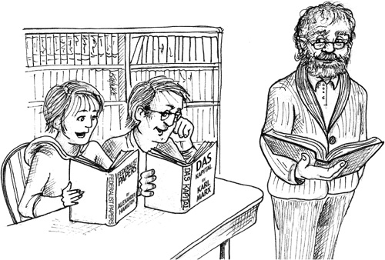
WHY CLEAN CLASSES?
Programming is the art of telling another human what one wants the computer to do. -Donald Knuth
In Time Tec – Company Confidential

Slide 4
CLASS ORGANIZATION
Classes Should be organized in the following order:
Public Static Constants
Private Static Variables
Private Instance Variables
Public Functions
Private Utility Functions
In Time Tec – Company Confidential

Slide 5
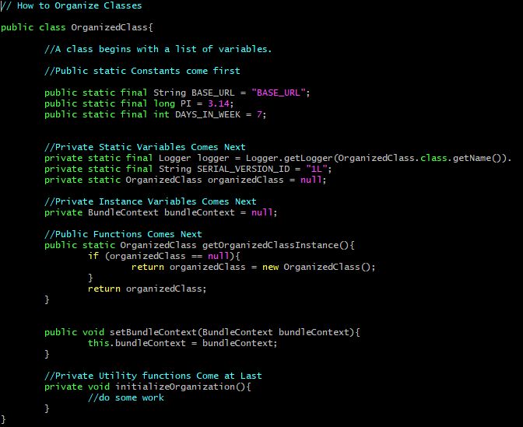
EXAMPLE
In Time Tec – Company Confidential

Slide 6
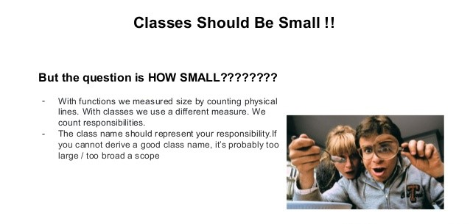
CLASSES SHOULD BE SMALL
In Time Tec – Company Confidential

Slide 7
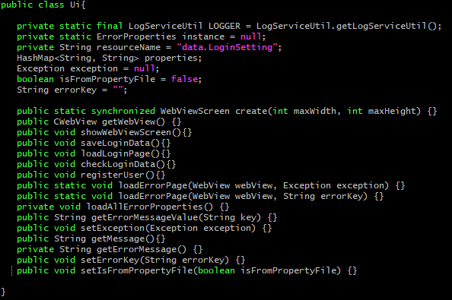
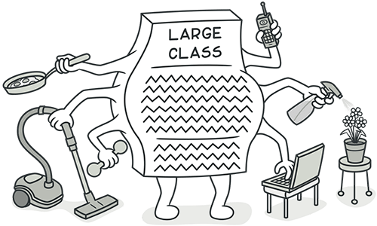
EXAMPLE
In Time Tec – Company Confidential

Slide 8
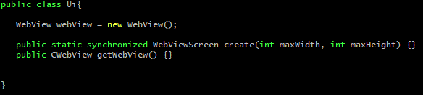
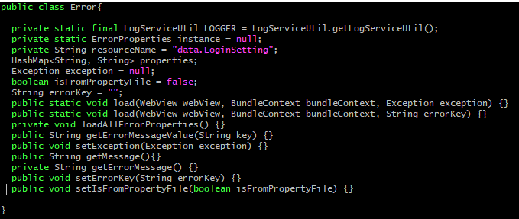
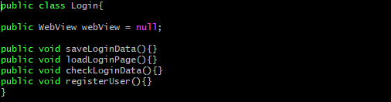
EXAMPLE
In Time Tec – Company Confidential

Slide 9
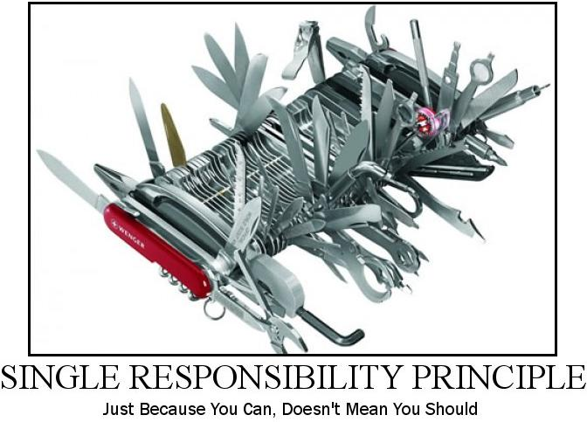
SINGLE RESPONSIBILITY PRINCIPLE
In this context, a responsibility is considered to be one reason to change. This principle states that if we have 2 reasons to change for a class, we have to split the functionality in two classes. Each class will handle only one responsibility and if in the future we need to make one change we are going to make it in the class which handles it. When we need to make a change in a class having more responsibilities the change might affect the other functionality related to the other responsibility of the class
In Time Tec – Company Confidential

Slide 10
SRP VOILATION
In Time Tec – Company Confidential

Slide 11
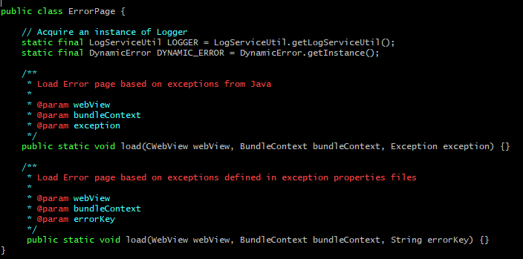
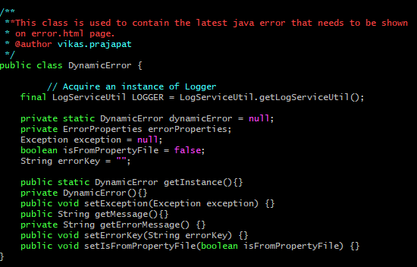
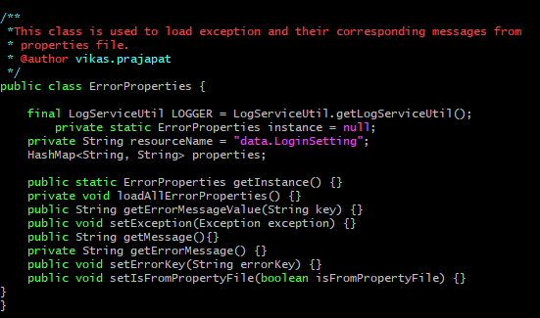
SRP UPHOLDING
In Time Tec – Company Confidential

Slide 12
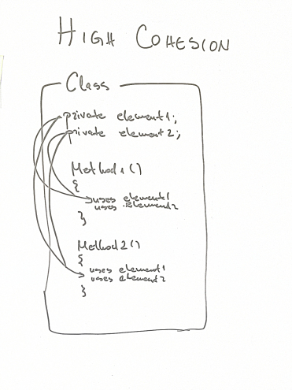
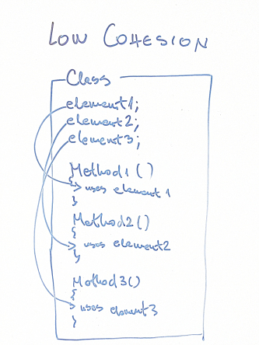
COHESION
In Time Tec – Company Confidential

Slide 13
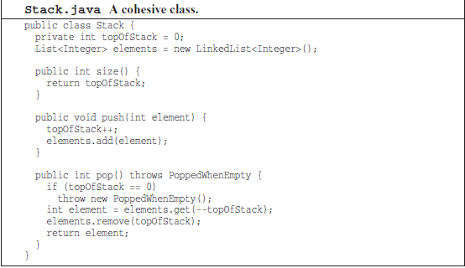
EXAMPLE
In Time Tec – Company Confidential

Slide 14
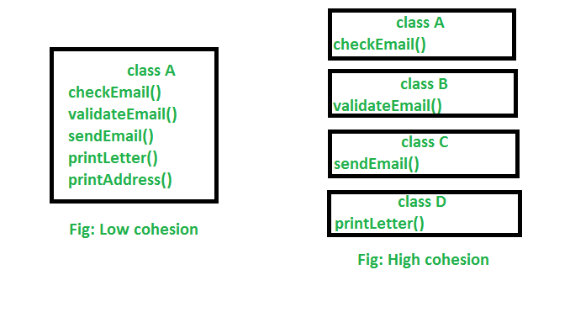
MAINTAINING COHESION RESULTS IN MANY SMALL CLASSES
In Time Tec – Company Confidential

Slide 15
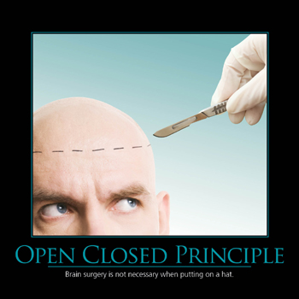
ORGANIZING CLASSES FOR CHANGE
In Time Tec – Company Confidential

Slide 16
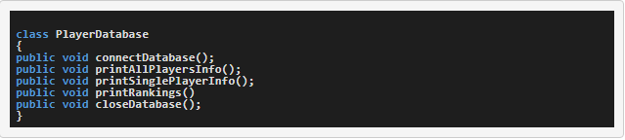
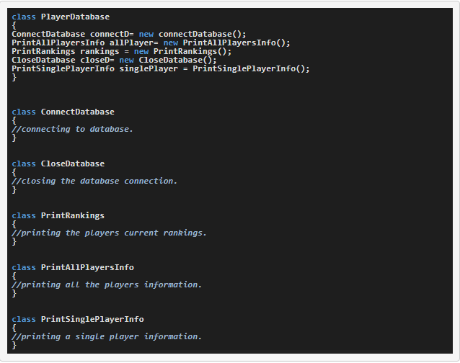
ORGANIZING FOR CHANGE
In Time Tec – Company Confidential

Slide 17
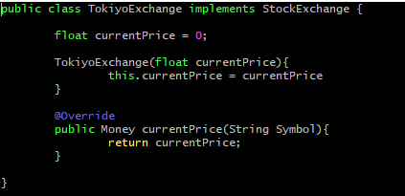

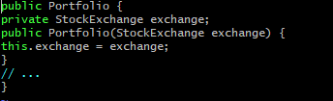
ISOLATING FROM CHANGE
In Time Tec – Company Confidential

